Slide 1
Action Verbs
I can identify an action verb.
I know I have learned this because I can find the action verb in the sentence.

Slide 2
Action Verbs
Read the sentence when I say “Read.”

Slide 3
Dance to the music.
What is the verb?

Slide 4
Crawl on the floor
What is the verb?

Slide 5
Squawk like a chicken
What is the verb?

Slide 6
Flap your arms like a hawk.
What is the verb?

Slide 7
Catch a fish
What is the verb?

Slide 8
Moan and groan
What is the verb?

Slide 9
Solar | Cold mold | -oll | -olt | -ost
open | Gold Sold hold | roll | colt | most
over | Old Fold mold | toll | bolt | post
oval | Bold | stroll | jolt | host

Slide 10
I can read grade level words
High
Sight
Midnight
Quite
Diner

Slide 11
Write in your journals 5 sentences about this statement
What has Kurt learned about diners?

Slide 12
I can identify a noun and a verb in a sentence.
She baked muffins for us.
The man ran to the gym.
He read that book at bedtime.
The dog jumped over the fence.
My teacher lives on a street near the school.

Slide 13
OW
What sound does ‘ow’ say

Slide 14
‘ow’
Down
Clown
Howl
Now
How
Cow
bow
Low
Tow
Row
Show
Crow
Blow
Below
Bellow
Fellow
Pillow

Slide 15
subway
I can read grade level text with a partner

Slide 16
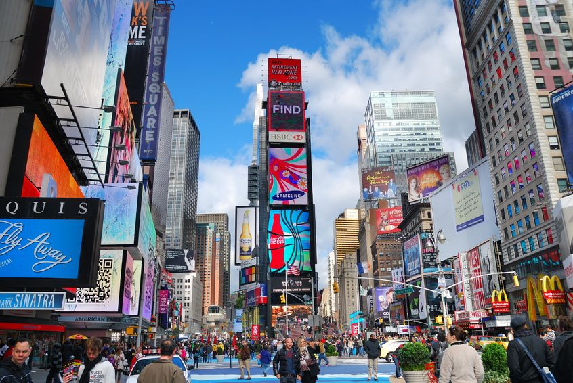
Vocabulary
Meal
Breathing
Seats
Hear
East
Train
Waited
Air
Subway
Day
Swayed
River
Under
Closer
Better
Finished
Waitress
Platform
Inside
Manhattan
Times Square a busy area of Manhattan consisting of shops and theaters

Slide 17
On a sticky note write down the different types of transportation you have used?

Slide 18
On an index card answer the following questions
Why does Kim want to go to Manhattan?
Describe the inside of the subway train?
What sounds does the subway make?
4. Why was Kurt having difficulty breathing?
5. Did Kurt and Kim end up getting seats?

